Slide 1
Making this resource work for you
Prior to teaching this lesson, please refer to the ‘Unit Overview and Planning Document’.
Further guidance on planning Science Mastery lessons can be found in the detailed planning guidance document.
Refer to the ‘notes’ section on each slide for useful information, including suggested expositions, pedagogical content knowledge, suggested questions, answers and more. Consider using presenter mode so you can see this guidance throughout the lesson.
The introduction slides can be adapted to suit your teaching style and the needs of your class.
Before the lesson, adapt the fix-it slide to address any misconceptions identified in the previous lesson’s exit ticket.
Choose from the suggested activities to suit your class. The intention is not that you complete all of these, but that you select those which ones are most appropriate for your students. It may be appropriate to further adapt activities for your students.
These lessons are designed to occupy approximately 1 hour. To adapt for a shorter or longer lesson duration we advise you to adapt the activity section accordingly.
Please consider using the final slide to send feedback about this lesson or examples of PowerPoints that you have adapted to our design team. Your feedback is used to improve Science Mastery for all of our teachers and students. We appreciate all suggestions and comments.
Thank you for reading!
The Science Mastery Team

Slide 2

Feedback Lesson
Answer the following questions:
Define acceleration.
State Newton’s First Law.
Explain what is shown by a horizontal line on a velocity-time graph.
Name the quantity that can be calculated from the gradient of a velocity-time graph.
State Newton’s Third Law.
The rate of change of velocity.
An object’s motion will not change unless acted upon by an unbalanced force.
An object moving with constant velocity.
Acceleration
Every action has an equal and opposite reaction. If object A exerts a force on object B, object B exerts an equal and opposite force on object A.
Notes:
Foundation question: Give an example of a scalar quantity and a vector quantity.
Answer: scalar (magnitude only): distance, speed, mass, energy. Vector (magnitude and direction): displacement, velocity, acceleration, force and weight.
Stretch question: Compare the features of distance-time graphs and velocity-time graphs.
Answer:
horizontal line: d-t graph = stationary, v-t graph = constant speed
Constant positive gradient: d-t graph = constant speed, v-t graph = constant acceleration
Constant negative gradient: d-t graph = travelling in opposite direction, v-t graph = constant deceleration
0 on the y axis: d-t graph = returned to original position, v-t graph = stationary

Slide 3
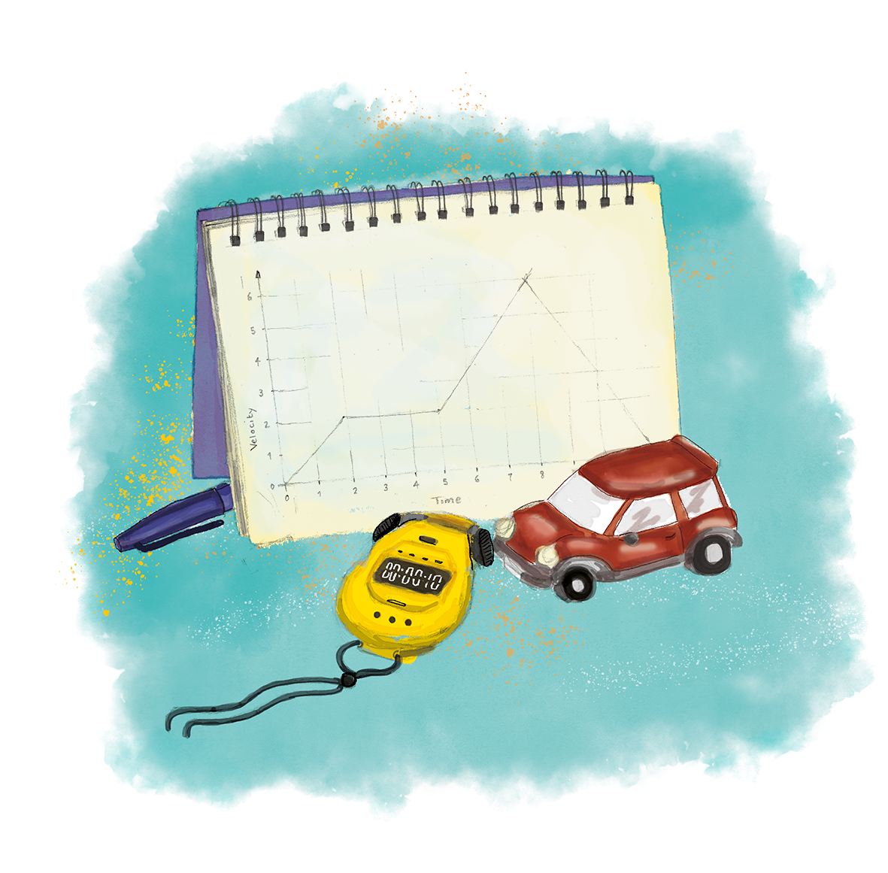
P3.1.12
07/11/2024
Feedback Lesson
P3.1.1 Prior Knowledge Review
P3.1.2 Scalars and Vectors
P3.1.3 Resultant Vectors
P3.1.4 Resolving Vectors
P3.1.5 Newton's Third Law
P3.1.6 Newton's First Law
P3.1.7 Acceleration
P3.1.8 Acceleration Investigation
Maths in Science Lesson 17
P3.1.9 Velocity-Time Graphs
P3.1.10 Velocity-Time Graphs 2
P3.1.11 Acceleration Problems

Slide 4
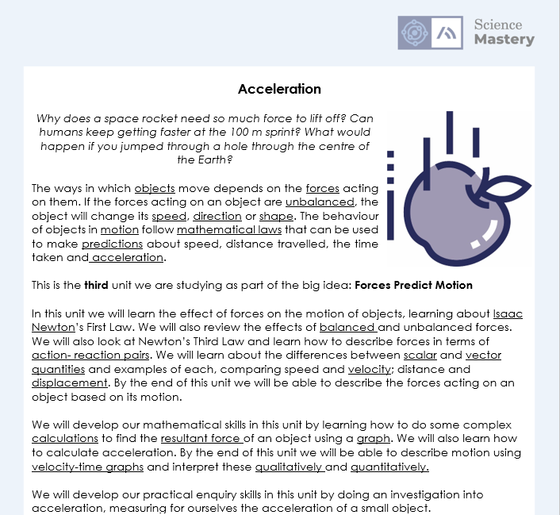
The Big Idea: Forces Predict Motion
Notes:
Purpose:. The purpose of this resource is to provide students with an overview at the beginning and end of each unit. It is designed to create a discussion about the unit prior to and at the end of the sequence of lessons.
Teacher guidance:
Pupils should be directed to the P3.1 Link to Big Ideas worksheet (either in their booklet or printed). This may be back at the beginning of the sequence of lessons.
Teachers should use guided reading techniques to read aloud with the pupils and then pupils should answer the reflection questions. This could be used to summarise what pupils have learnt.
Questions on the student sheet:
1. Tick off any words in the ‘words I haven’t seen before’ column that you are now confident with. Circle any you still need more practice to use.
2. What have you most enjoyed about this unit?
3. What more would you like to learn about the different types of forces as part of the big idea: ‘forces predict motion’?
There are a range of ways to use this resource:
1. Display on a slide for students to read as a class. Direct students to complete the activities in their book.
2. Print off for students to stick into their book at the beginning of the unit along with their knowledge organiser. Complete as a guided reading task together. Direct students to complete the activities.
3. Have students complete as part of a booklet.
Set as a homework to reflect on the unit.
If you have any feedback about how this resource could be used/improved, please contact the science mastery team: sciencemastery@arkonline.org

Slide 5

Answers
Question | Answer
1
2
3
4a
4b
5a
5b
5c
5d
6
7
8
9
10
11
B
B
A
A
A
B
B
B
C
B
B
B
C
A
D
Notes:
Purpose: for students to correct their answers so they can see where they made errors and have a corrected quiz stuck in their books
Suggested guidance: talk through each question and cold call students to explore why the incorrect options are wrong. Students should write annotations on their marked quiz so they can revise from it.

Slide 6
Answers
distance, speed, mass or energy
Displacement is how far an object is from its original position or from a point of reference in a given direction.
An object moving in a circle at constant speed is accelerating because acceleration is the change in speed or direction. This means that the object is accelerating because it is constantly changing direction.
Notes:
Purpose: for students to correct their answers so they can see where they made errors and have improved their Section B answers.
Suggested guidance: talk through each question and cold call students to explore why the incorrect options are wrong. Students should write annotations on their marked quiz so they can revise from it.

Slide 7
Answers
4.
Velocity
0
10
20
40
50
Time (seconds)
Notes:
Purpose: for students to correct their answers so they can see where they made errors and have improved their Section B answers.
Suggested guidance: talk through each question and cold call students to explore why the incorrect options are wrong. Students should write annotations on their marked quiz so they can revise from it.

Slide 8
Complete your fix it task
Edit according to class performance on quiz
If you got Q1 or Q2 wrong…
Write the task instructions here. E.g. Complete X worksheet / write out the method / draw labelled diagrams of…
If you got Q3 wrong…
Write the task instructions here. E.g. Complete X worksheet / write out the method / draw labelled diagrams of…
If you got Q6 or Q7 wrong …
Write the task instructions here. E.g. Complete X worksheet / write out the method / draw labelled diagrams of…
Notes:
Purpose: for students to complete activities that improve their understanding of an aspect of the mastery quiz.
Guidance: These are not the only fix it tasks that might be appropriate but they are a starting point.

Slide 9
Measuring Acceleration
A company have decided to introduce their own Formula One Team and claim their car will have a faster acceleration than all existing cars
Write a method to describe how you could test the company’s claim
Ensure you include your independent, dependent and control variables
Ensure your method would produce valid results
Notes:
Purpose: use as a consolidation activity so pupils are bringing together as much of the residual knowledge from the topic as possible and applying it.
Scaffold suggestions for pupils – working in groups, give sentence starters, questioning to determine variable, include various levels of model answer so pupils can choose the best option.
Award credit for:
Independent variable – type of car
Dependent variable – acceleration
Control variables – time measured, initial velocity (rest), road surface (so friction is equal), weather surfaces (so drag is equal)
Method:
Choose several different cars to compare
Start the cars from rest
Measure the speed of each car after 10 seconds (or any given time period)
Use a = (v-u)/t equation to solve for acceleration

Slide 10
Answer the questions below.
1. Acceleration is …
A. An increase in velocity
B. A change in speed
C. A change in velocity
2. An object that was moving at a constant speed towards the right is acted upon by a resultant force of 50 N right. The object will…
A. Accelerate towards the right
B. Accelerate towards the left
C. Slow down to a stop
3. What is the acceleration of a car that goes from rest to 15 m/s in 10 seconds?
A. 0.67 m/s²
B. 1.5 m/s²
C. -1.5 m/s²
✓
✓
✓
Notes:
Answers
C
A
B

Slide 11
Lesson P3.1.12
What was good about this lesson? | What can we do to improve this lesson?
Send us your feedback by clicking this link. Thank you!

